Slide 1
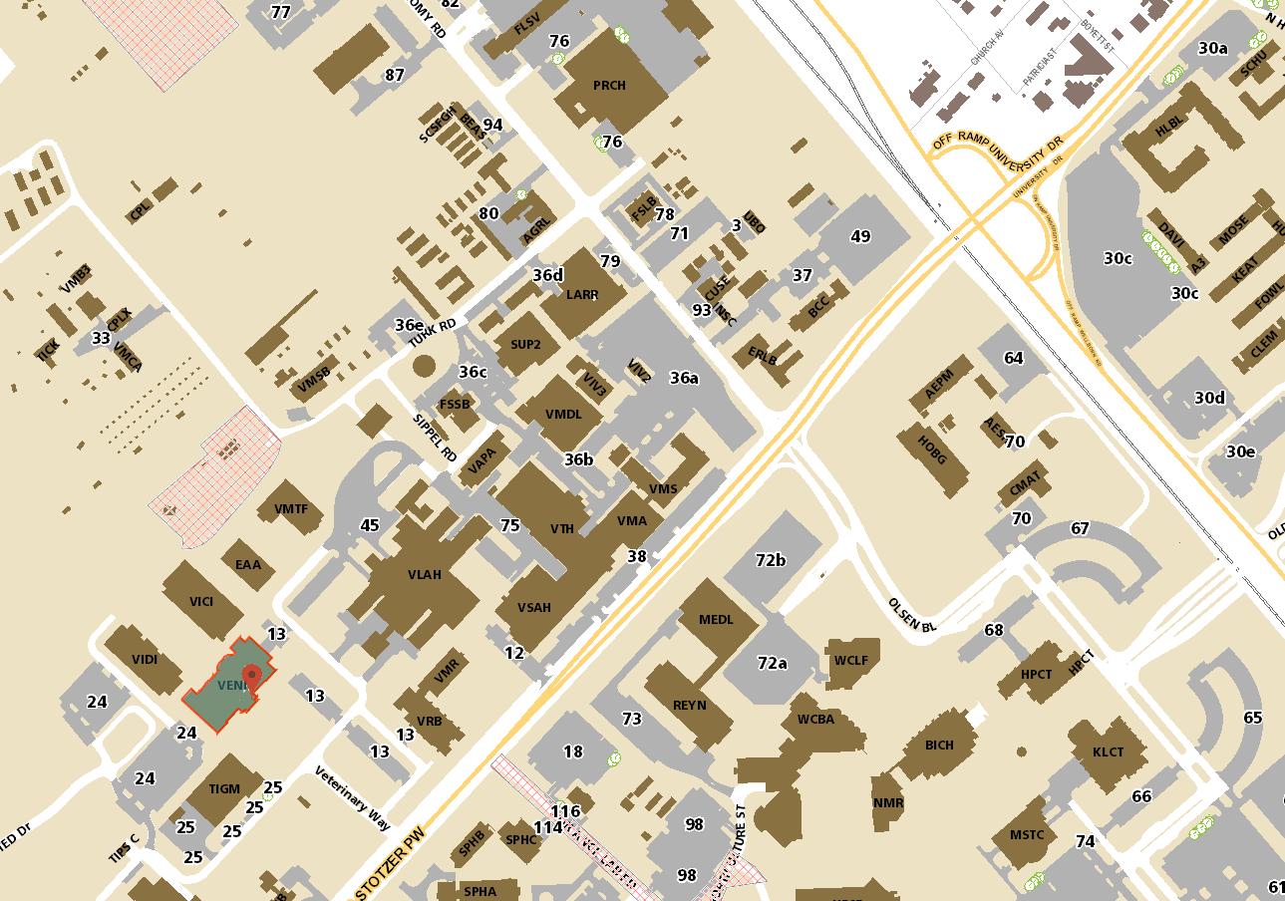
Monday meeting location – Registration front entrance lobby
9:30-10:30am Monday
Veterinary Medicine Building 1 (Built in 2016) Address: 660 Raymond Stotzer Parkway Building Number: 1812 Abbreviation: VENI
Dorms
0.9 Mile from Dorm
Google says 18 min walk
Sidewalks all the way
Day 1 Location
VENI building
Park in visitors spots if you are not local
http://transportmap.tamu.edu/parkingmap/tsmap.htm?map=timed&bldg=1812

Slide 2
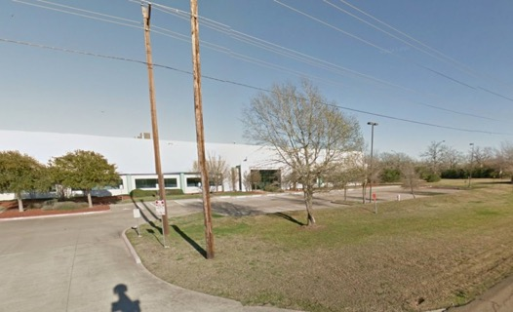
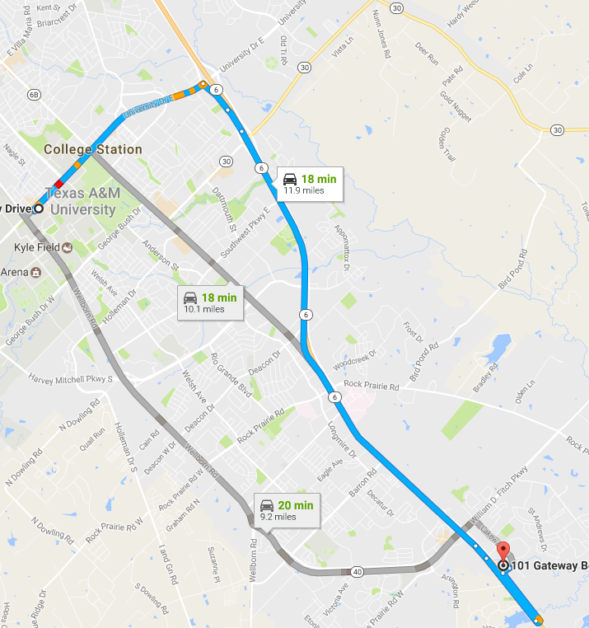
TxGen Labs
Site of PoreCampUSA 2017
Tuesday – Friday
Start 8:30pm
http://www.txgen.tamu.edu/contacts/location/
AgriLife Genomics and Bioinformatics Service 101 Gateway, Suite A College Station TX 77845
Lab Phone: (979) 862-2143
If you are going south on Highway 6 (from TAMU), take the Nantucket exit and make a U-turn under the bridge to get onto the northbound HW6 feeder road. From the feeder road make a right turn into our complex, take the right immediately after passing the business park entrance (Gateway Blvd). We are located in Suite A of this building, which is on the right hand side.
Please park in the front of the building.

Slide 3
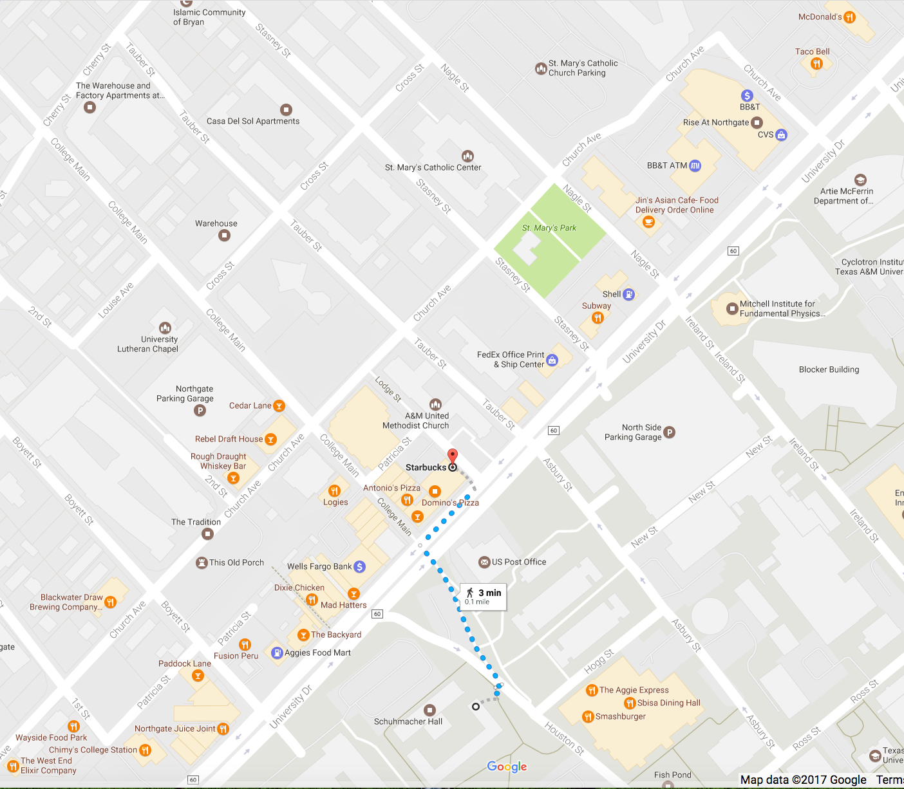
Pick up times and points of interest in North Gate
Great Pizza place
The Dixie Chicken
Famous Aggie watering hole
Sunday meet up. ~19:00
Blackwater Draw Brewing
Starbucks
Dorm Pick-up Location
Monday: Leaving 9:30am
Tuesday – Friday: Leaving 8:00am
Walton Hall Dorm

Slide 4

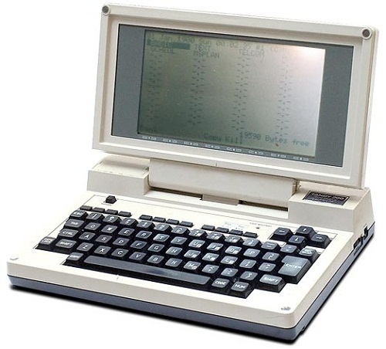
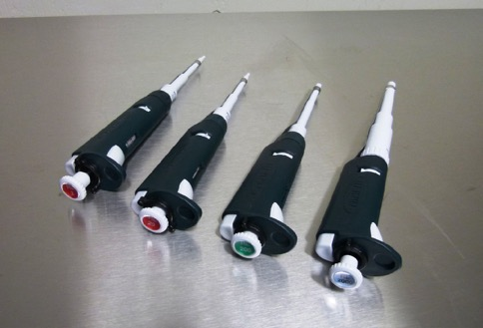

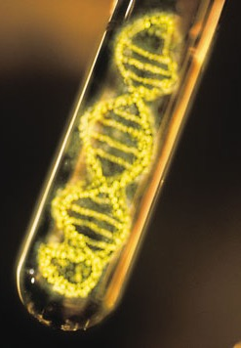



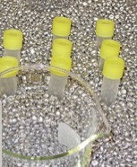

What to bring
Set of Pipettes
Pens, markers and something suitable for use as a lab-book
DNA samples
We have “Ice”
Modern Laptop
Come ready to learn
We will try to keep things running on time

Slide 5
Jester King Friday
Bus will leave TxGen Labs at 12:00
Arrive at Jester King ~2:30
Start sequencing
Tour of Jester King Brawery 5:30
Salt Lick BBQ and Jester King Pizza Dinner
Head back to College Station 9:00
Arrive back at TxGen 11:30
http://jesterkingbrewery.com/
13005 Fitzhugh Rd., Bldg. B
Austin, TX 78736

